Slide 1
Chapter 9 – 8088/86 Microprocessors and Supporting Chips
CSE 3442
Tom Rethard

Slide 2
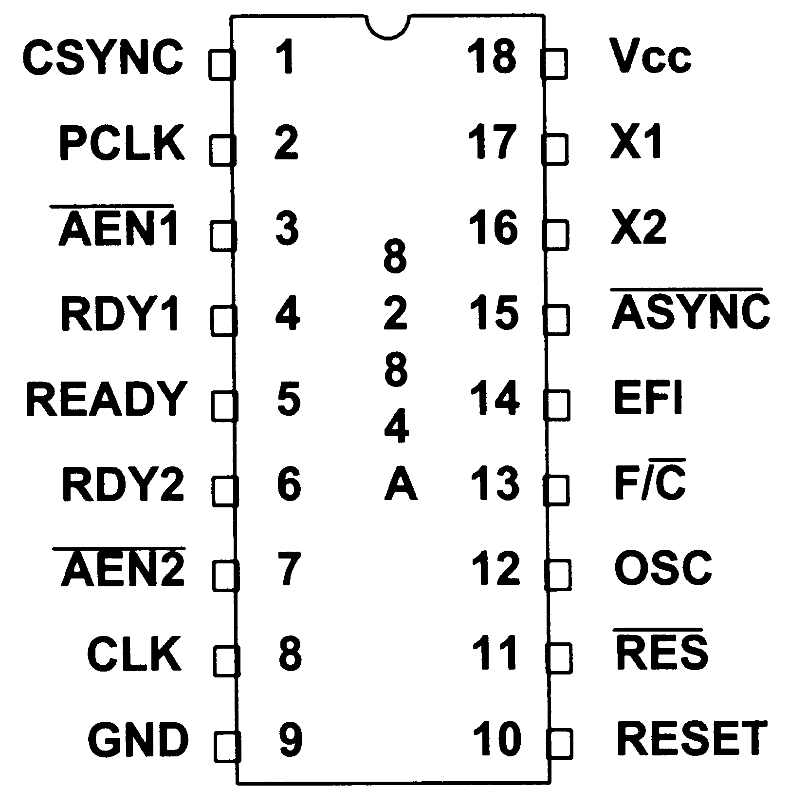
8284 Clock Generator and Driver
RES in
Reset

Slide 3
8284 Clock Inputs
RES
X1 & X2
F/C
EFI
CSYNC
RDY1 & AEN1
RDY2 & AEN2
ASYNC

Slide 4
8284 Clock Generator and Driver
X1 and X2
Crystal In
Max freq is 24Mhz
  30Mhz for 8284A1
  IBM PC uses 14.31818Mhz

Slide 5
8284 Clock Generator and Driver
F/C
freq/clock select
low - uses crystal
high - clock in on EFI

Slide 6
8284 Clock Generator and Driver
EFI
External Frequency In
Used in “turbo” PCs for higher freq

Slide 7
8284 Clock Generator and Driver
CSYNC
Clock Sync
Permits multiple 8284s to use same clock signal

Slide 8
8284 Clock Generator and Driver
RDY1 and AEN1
Ready 1
Address Enable 1
Provide ready signal to CPU to insert a wait state
RDY1 connected to DMAWAIT
AEN1 connected to RDY/WAIT

Slide 9
8284 Clock Generator and Driver
RDY2 & AEN2
Ready 2
Address Enable 2
Used in multiprocessing systems
In UP systems:
  RDY2 always low
  AEN2 always high

Slide 10
8284 Clock Generator Outputs
RESET
OSC
CLK
PCLK
READY

Slide 11
8284 Clock Generator and Driver
RESET
Reset out
Sends reset signal to CPU

Slide 12
8284 Clock Generator and Driver
OSC
Oscillator
Provides clock freq equal to the crystal to expansion slots

Slide 13
8284 Clock Generator and Driver
CLK
Clock
Output clock
1/3 of clock input freq
Output to pin 19 of CPU or CLK88 of other chips

Slide 14
8284 Clock Generator and Driver
PCLK
Peripheral clock
Output 1/6 input freq to 8253 timer
  speaker tones
  other functions

Slide 15
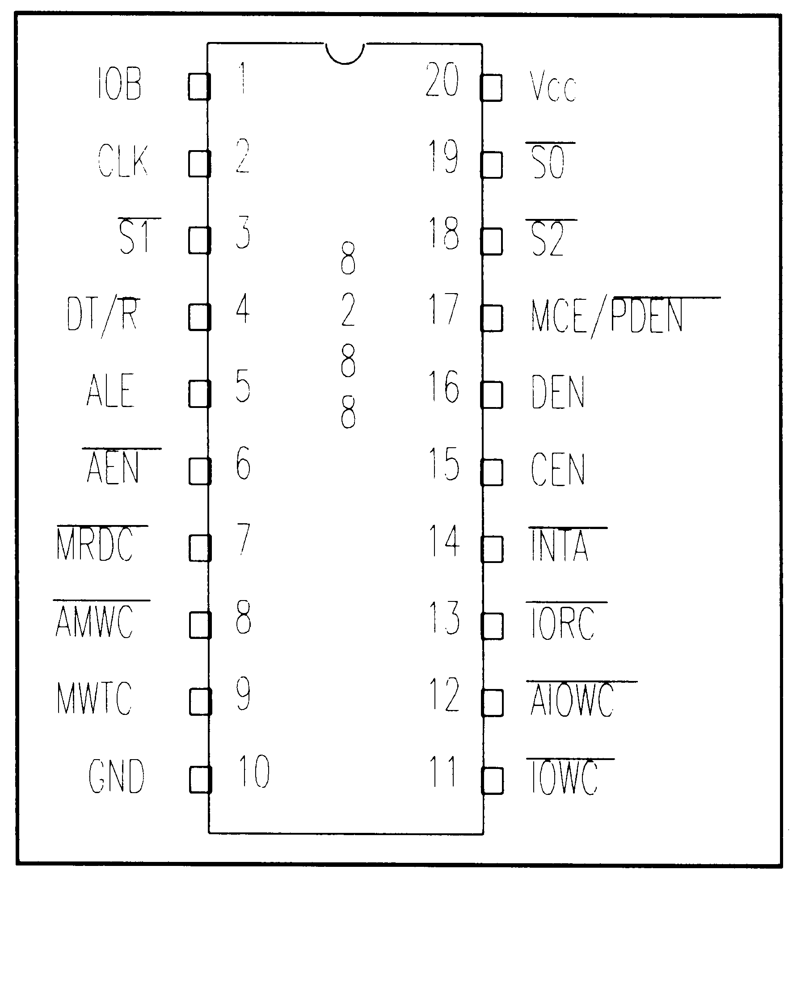
8288 Bus Controller

Slide 16
8288 Bus Controller
Provides control signals for CPU in maximum mode

Slide 17
8288 Bus Controller Inputs
S0, S1 and S2
CLK
AEN
CEN
IOB

Slide 18
8288 Bus Controller Inputs
S0, S1 and S2
Input from CPU in max mode

Slide 19
8288 Bus Controller Inputs
CLK
Clock input

Slide 20
8288 Bus Controller Inputs
AEN
Activates 8288 command output >= 150ns after activation

Slide 21
8288 Bus Controller Inputs
CEN
Command Enable
Enables command signals and DEN
Connected to AEN generating circuitry

Slide 22
8288 Bus Controller Inputs
IOB
Input/output bus mode
IO Bus mode when high
System bus when low
  PC default

Slide 23
8288 Bus Controller Outputs
MRDC
MWTC
IORC
IOWC
INTA
DT/R
DEN
MCE/PDEN
ALE

Slide 24
8288 Bus Controller Outputs
MRDC
Memory read command
Provides MEMR control signal
Causes memory device to release data to data bus

Slide 25
8288 Bus Controller Outputs
MWDC, AMWC
Memory write command, advanced memory write command
Provides MEMW control signal
Causes memory device to accept data from data bus

Slide 26
8288 Bus Controller Outputs
IORC
I/O read command
Tells I/O device to release data to data bus

Slide 27
8288 Bus Controller Outputs
IORW
I/O write command
Tells I/O device to accept data from data bus
Unused in IBM PC

Slide 28
8288 Bus Controller Outputs
INTA
Interrupt acknowledge
Acknowledges interrupt request and provides vector entry
Connected to INTA of 8529 interrupt controller in PC

Slide 29
8288 Bus Controller Outputs
DT/R
Data transmit/receive
Controls direction of data in and out of the CPU
Connected to DIR of 74LS245 (transceiver chip attached to data bus

Slide 30
8288 Bus Controller Outputs
DEN
Data enable
High makes the data bus a local data bus or the system data bus
Used with a signal from the 8259 to activate G of the 74LS245

Slide 31
8288 Bus Controller Outputs
MCE/PDEN
Master cascade enable/peripheral data enable
Used with 8259 in master configuration
Ignored on the PC
  used in slave mode

Slide 32
8288 Bus Controller Outputs
ALE
Address latch enable
Selected destination for AD0-AD7 of CPU
Connected to G input of 74LS373

Slide 33
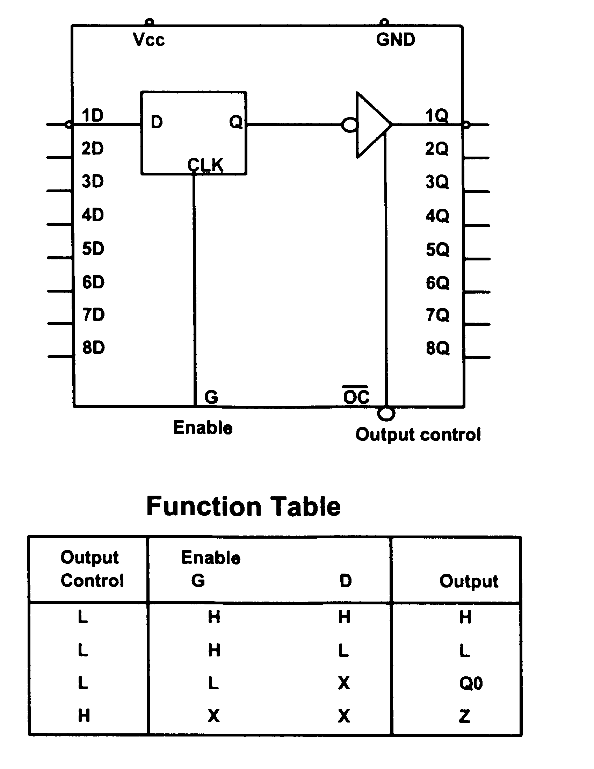
74LS373

Slide 34
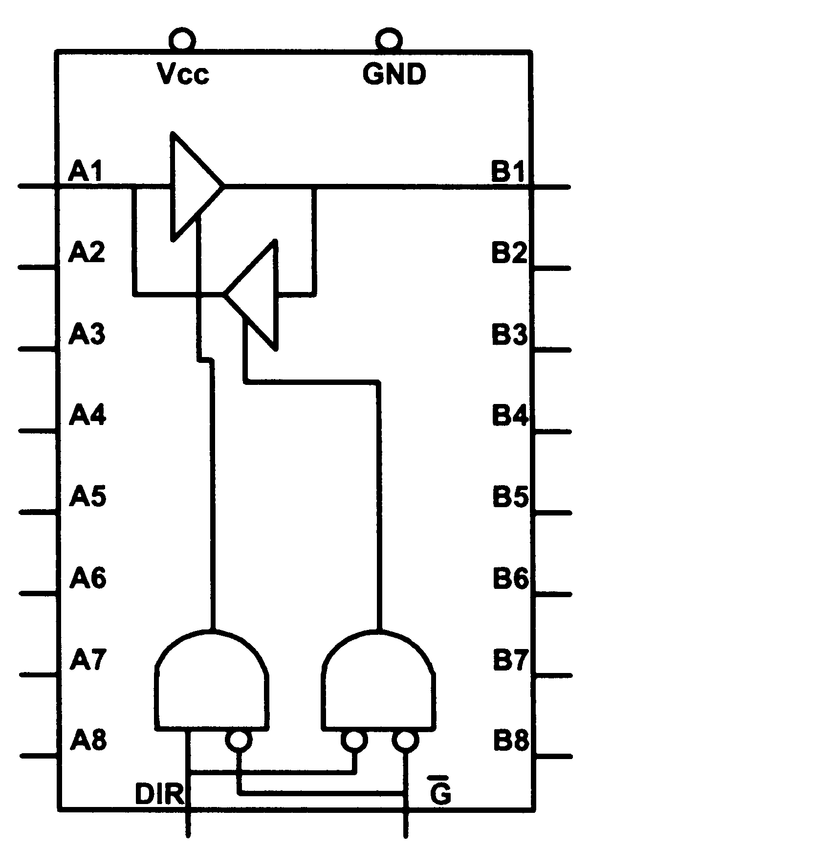
74LS245 Bi-directional buffer

Slide 35
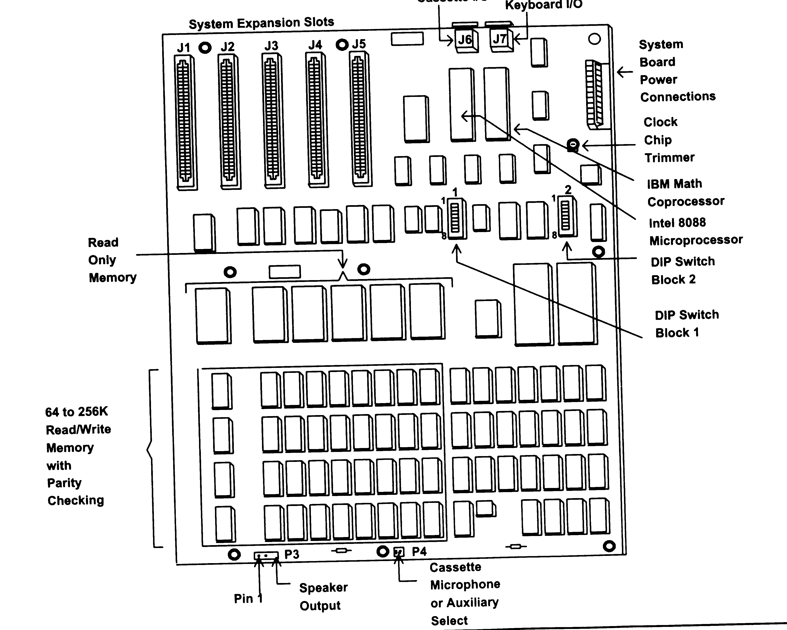
PC-1 Motherboard (not PC/XT)

Slide 36
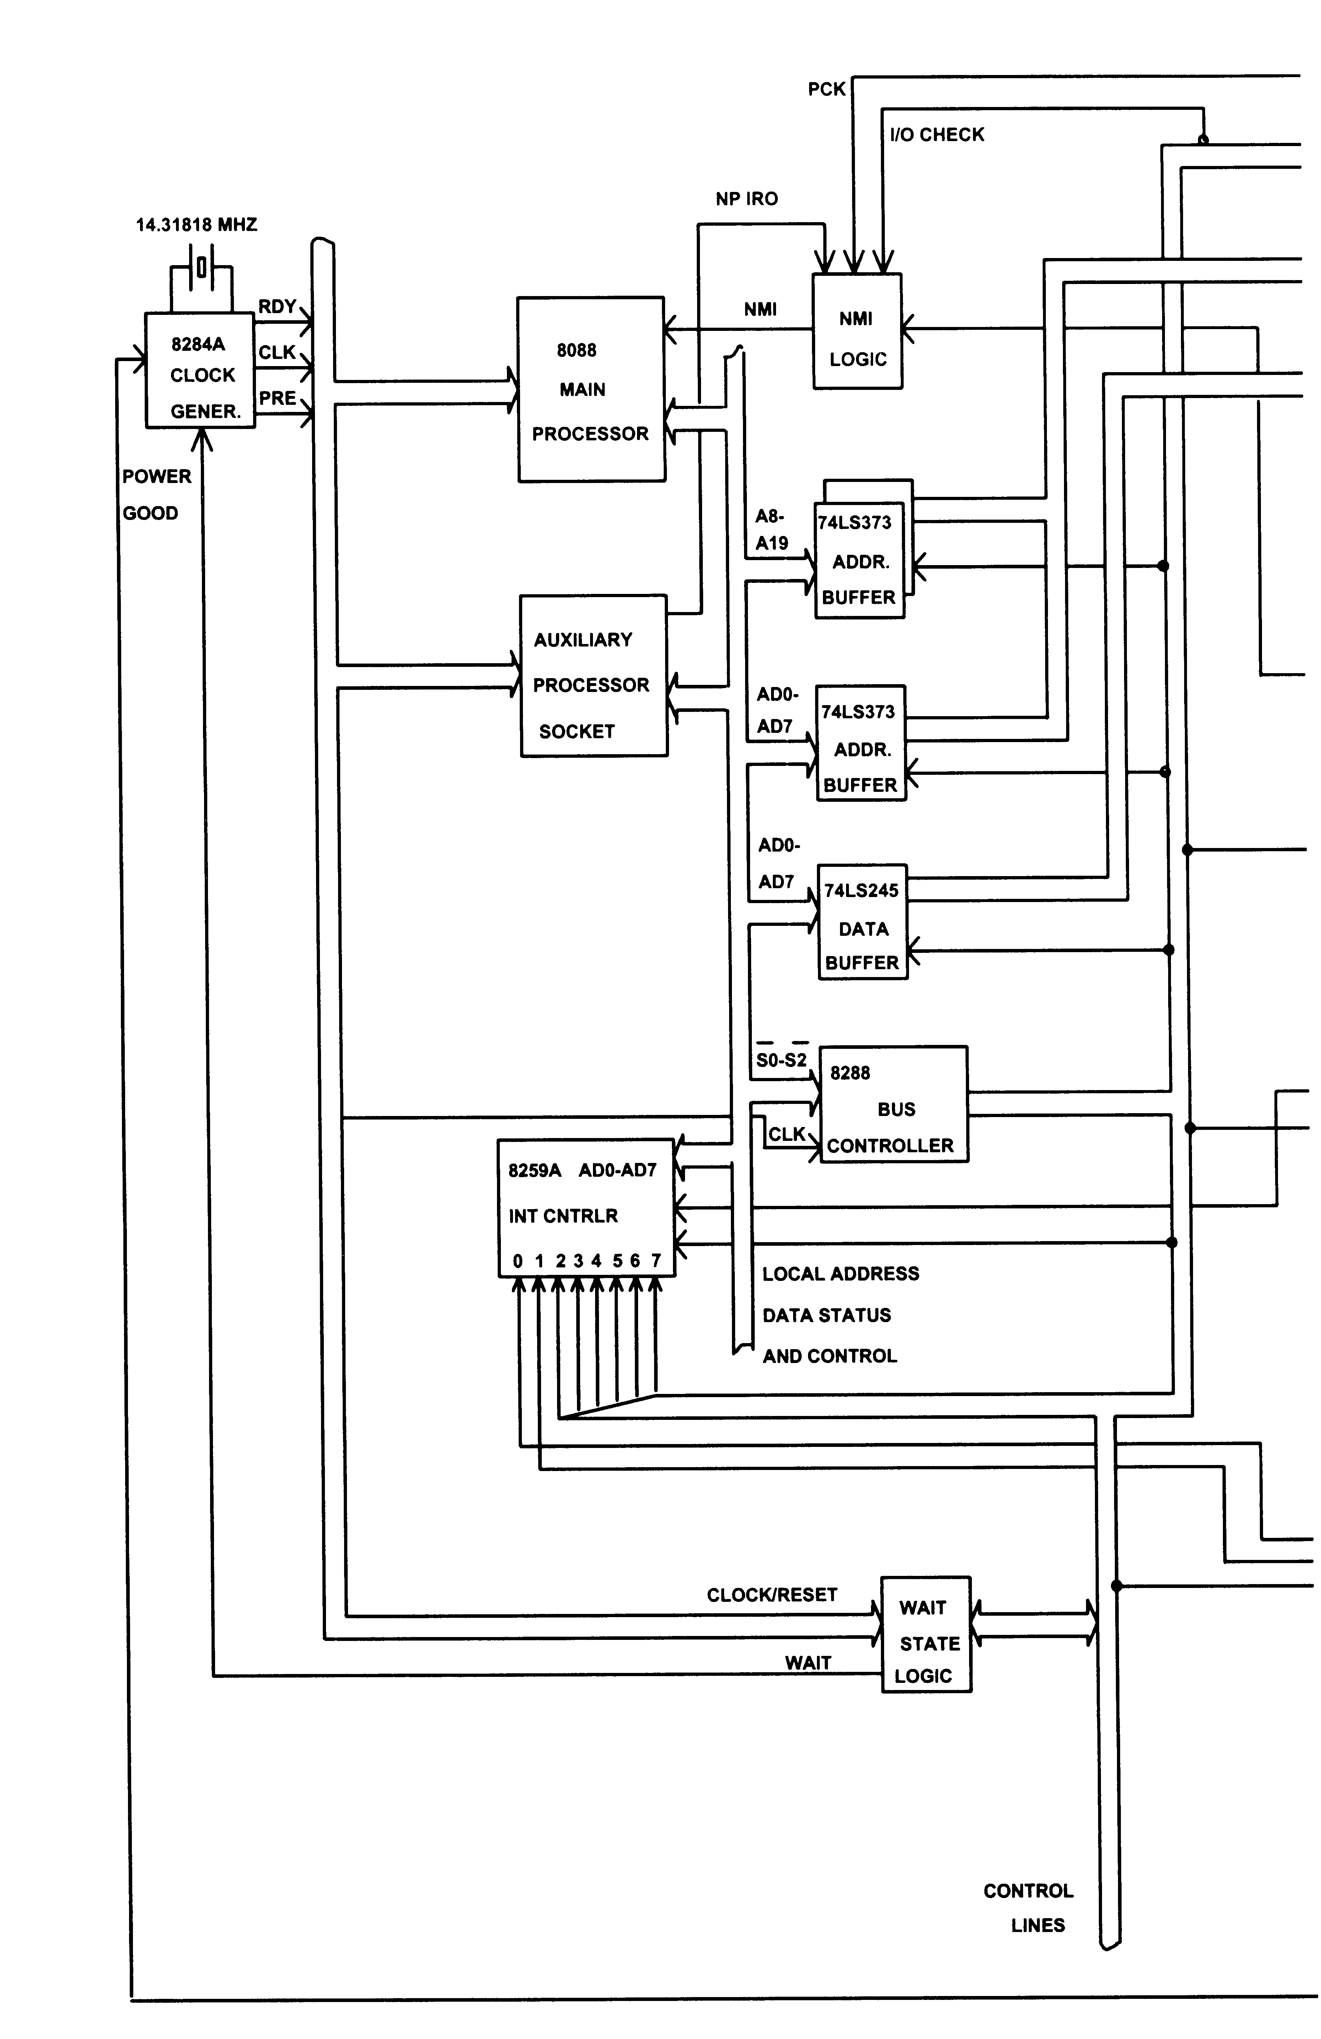
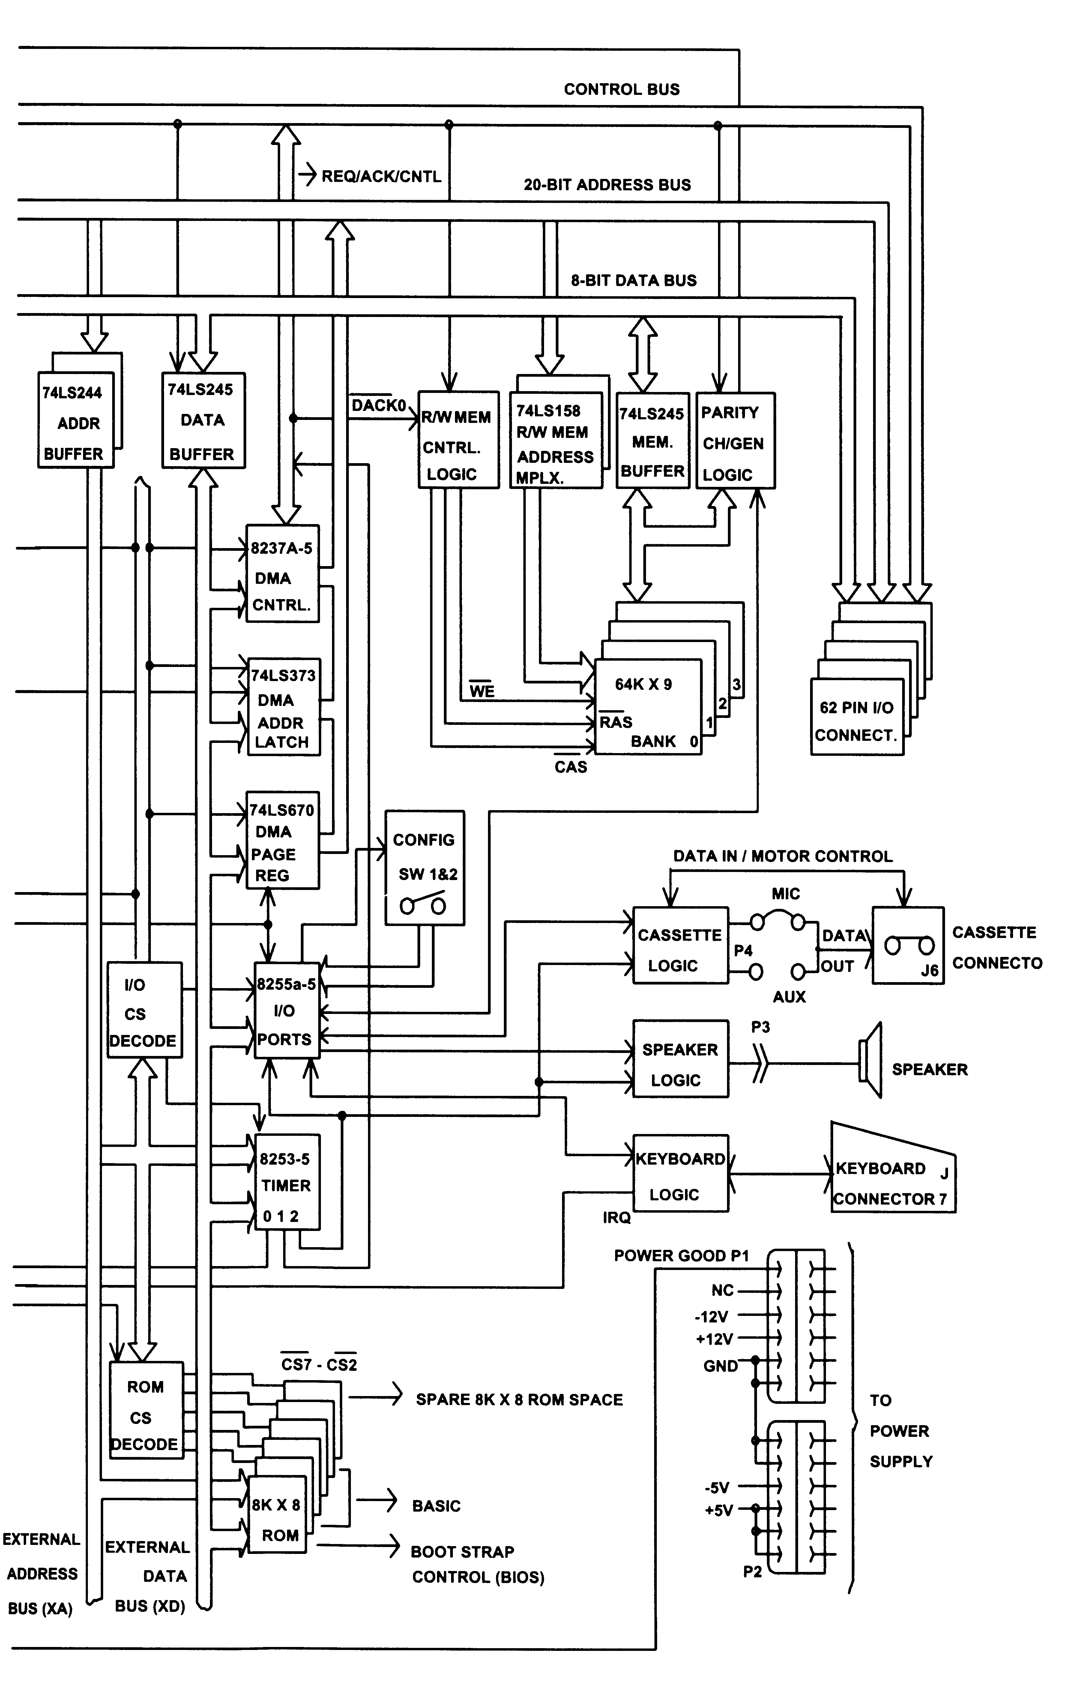
PC Dataflow

